Slide 1
Project Management & Information Technology

Slide 2
Projects Cannot Be Run In Isolation
Projects must operate in a broad organizational environment
Project managers need to use systems thinking
Senior managers must make sure projects continue to support current business needs

Slide 3
A Systems View of Project Management
A systems approach emerged in the 1950s to describe a more analytical approach to management and problem solving
Includes:
Systems philosophy
Systems analysis
Systems management

Slide 4
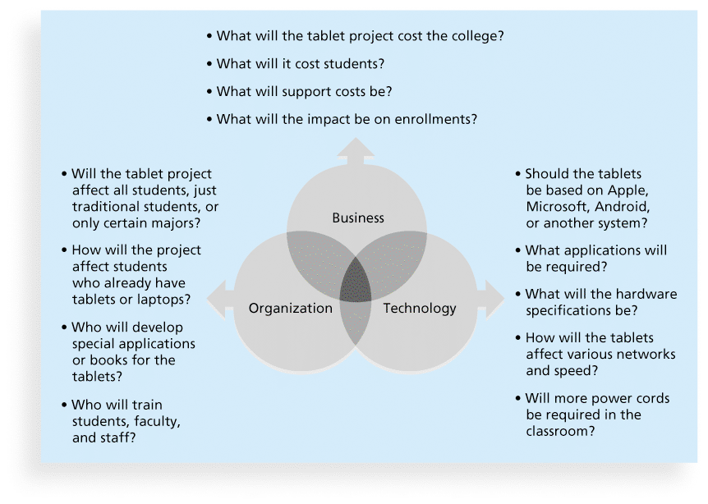
Three Sphere Model for Systems Management

Slide 5
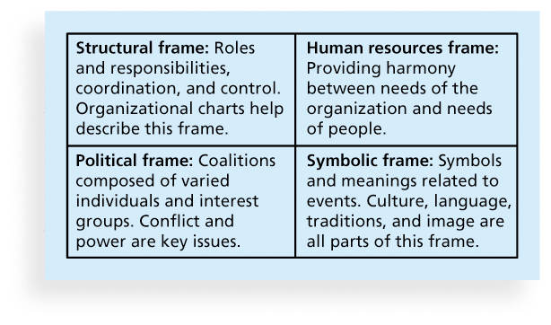
Perspectives on Organizations

Slide 6
Factors Influencing IT Project Management
Organizational Structure
Organizational Culture
Top Management Commitment
Stakeholder Management
Commitment to IT
IT Governance/Organizational Standards

Slide 7
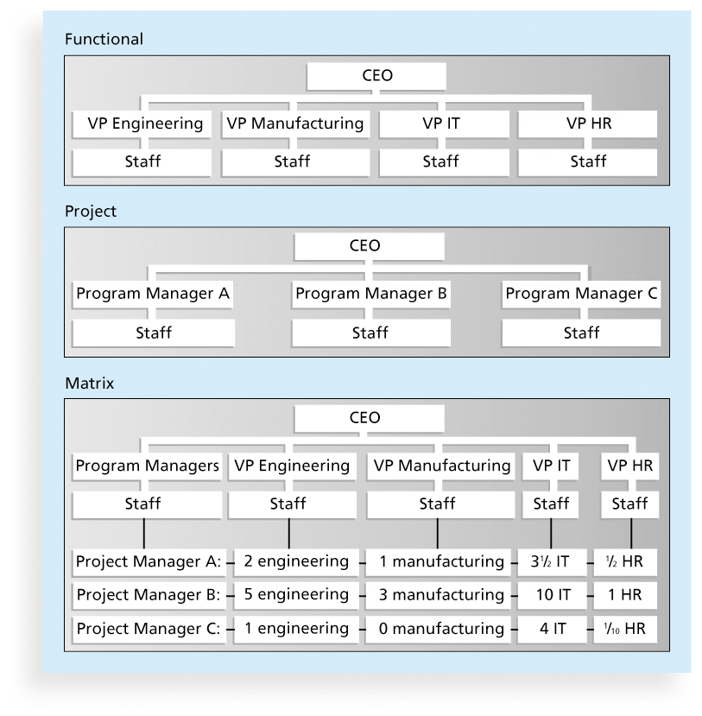
Organizational Structures
3 basic organization structures
Functional
Project
Matrix

Slide 8
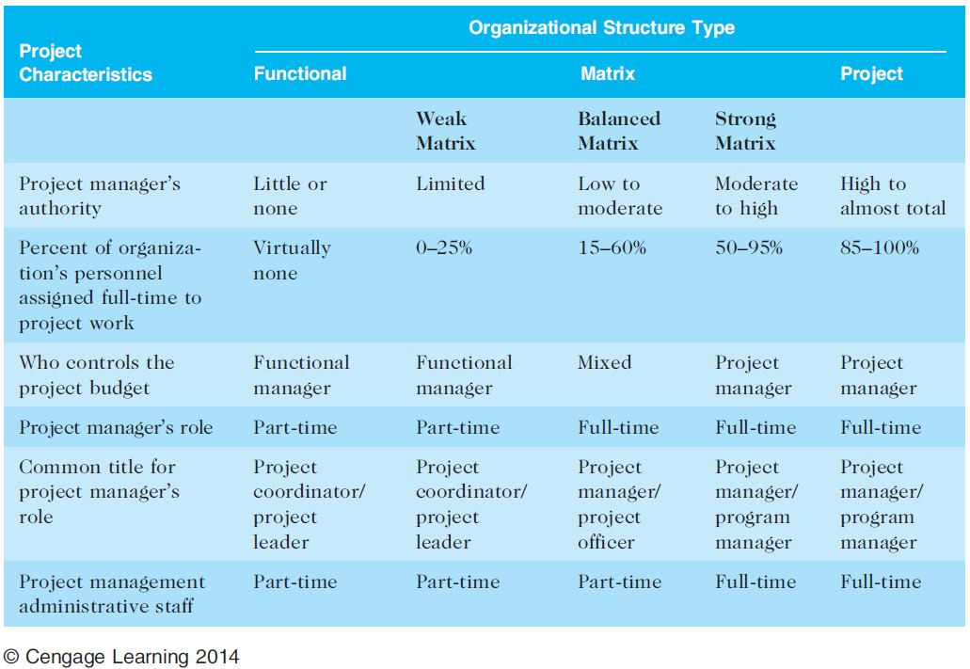
Organizational Structure Influences on Projects

Slide 9
Organizational Culture
Organizational culture is a set of shared assumptions, values, and behaviors that characterize the functioning of an organization
Characteristics of Org. Culture
Member identity*
Group emphasis*
People focus
Unit integration*
Control
Risk tolerance*
Reward criteria*
Conflict tolerance*
Means-ends orientation
Open-systems focus*

Slide 10
Top Management Commitment
People in top management positions are key stakeholders in projects
A very important factor in helping project managers successfully lead projects is the level of commitment and support they receive from top management
How does Top Management help a project?

Slide 11
Stakeholder Management
Project managers must take time to identify, understand, and manage relationships with all project stakeholders
Using the four frames of organizations can help meet stakeholder needs and expectations
Who is often considered one of the most important stakeholders?

Slide 12
Organizational Commitment to IT
If the organization has a negative attitude toward IT, it will be difficult for an IT project to succeed
Having a Chief Information Officer (CIO) at a high level in the organization helps IT projects
Assigning non-IT people to IT projects also encourage more commitment

Slide 13
IT Governance / Standards
IT governance addresses the authority and control for key IT activities in organizations, including IT infrastructure, IT use, and project management
Standards
PMO or simply having templates/forms
Example: Texas Tech IT PM Standards

Slide 14
Project Phases and the Project Life Cycle
A project life cycle is a collection of project phases that defines
what work will be performed in each phase
what deliverables will be produced and when
who is involved in each phase, and
how management will control and approve work produced in each phase
A deliverable is a product or service produced or provided as part of a project

Slide 15
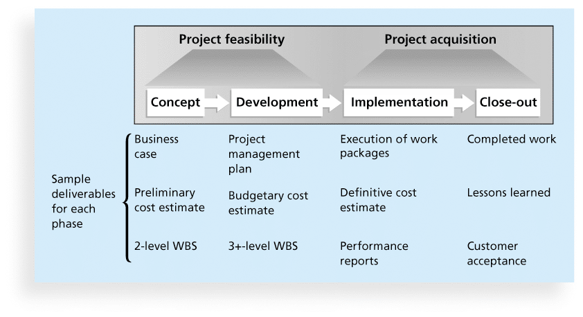
Phases of the Traditional Project Life Cycle

Slide 16
Product Life Cycles
The Systems Development Life Cycle (SDLC) is a framework for describing the phases involved in developing and maintaining information systems
Systems development projects can follow
Predictive life cycle
Adaptive Software Development (ASD) life cycle

Slide 17
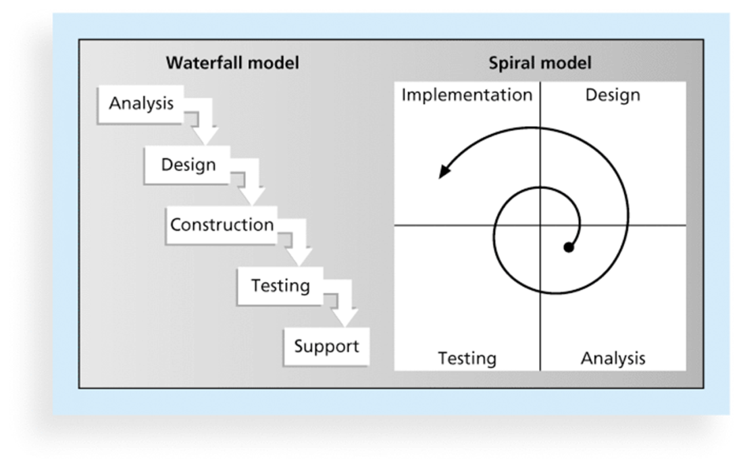
Examples of Predictive Life Cycle Models
Waterfall model
Spiral model
Incremental build model
Prototyping model
Rapid Application Development (RAD) model

Slide 18
Agile Software Development
Agile software development has become popular to describe new approaches that focus on close collaboration between programming teams and business experts

Slide 19
The Importance of Project Phases and Management Reviews
A project should successfully pass through each of the project phases in order to continue on to the next
Management reviews, also called phase exits or kill points, should occur after each phase to evaluate the project’s progress, likely success, and continued compatibility with organizational goals

Slide 20
The Context of IT Projects
Diverse in terms of size, complexity, products produced, application area, and resource requirements
Diverse IT Project Team Members
Diverse Technologies

Slide 21
Improving Likelihood of Success for IT Projects
Value-Driven Approach
Socio-Technical Approach
Commit to Project Management Principles (Chaos Report)
Knowledge-Management Approach

Slide 22
Recent Trends Affecting IT Project Management
Globalization
Outsourcing
Virtual teams

Slide 23
Globalization
Issues
Communications
Trust
Common work practices
Tools
Suggestions
Employ greater project discipline
Think global but act local
Keep project momentum going
Use newer tools and technology

Slide 24
Outsourcing
Organizations remain competitive by using outsourcing to their advantage, such as finding ways to reduce costs
Their next challenge is to make strategic IT investments with outsourcing by improving their enterprise architecture to ensure that IT infrastructure and business processes are integrated and standardized

Slide 25
Virtual Teams: Advantages/Disadvantages
Advantages:
Increasing competiveness and responsiveness
Lowering costs
Increased expertise and flexibility
Increased work/life balance
Disadvantages:
Isolation &Interpersonal Relationships
Communication Problems
Dependence on Technology

Slide 26
Approaches and Philosophy
eXtreme Project Management (XPM)
Holistic veiw of planning and managing
Projects don’t always fit traditional scheduling and formal techniques (they are chaotic)
Focuses on the “human side” of PM
Agile Project Management
Iterative, incremental approach
Popular
http://www.pmi.org/Certification/New-PMI-Agile-Certification.aspx

Slide 27
Chapter Summary
Systems approach when working on projects
Organization frames: structural, human resources, political, and symbolic
Project managers need to consider several factors due to the unique context of information technology projects
Recent trends affecting IT project management include globalization, outsourcing, virtual teams, and Agile

