Slide 1
Project Scope Management

Slide 2
Project Integration Management Processes
Process Group | Integration Management Process | Major Output
Initiating | Developing the project charter | Project Charter
Planning | Developing the project management plan | Project Management Plan
Executing | Directing and managing project work | Deliverables, work performance info, change requests
Monitoring and Controlling | (1) Monitor/Control Project Work (2) Perform Integrated Change Control | (1) Change Requests (2) Status updates
Closing | Close Project/Phase | Product Transition

Slide 3
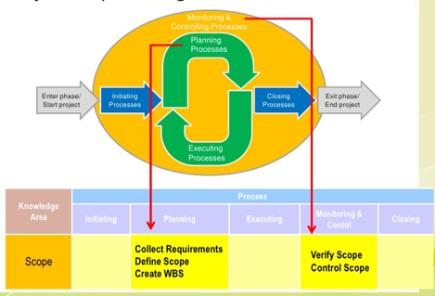
What is Project Scope Management?
Scope refers to all the work involved in creating the products of the project and the processes used to create them

Slide 4
Project Scope Management Processes
Process Group | Scopen Management Process | Major Output
Planning | P1: Plan Scope Management | Scope Mgmt Plan Requirement Mgmt Plan
 | P2: Collect Requirements | Req. Documentation Req. Traceability Matrix
 | P3: Define Scope | Project Scope Stmt Project Docs Update
 | P4: Create WBS | Scope Baseline Project Docs Update
Monitoring and Controlling | MC1: Validate Scope | Accept Deliverables Change Requests Work Performance Info
 | MC2: Control Scope | Change Requests Project Mgmt Plan Updates Org, Process Asset Updates

Slide 5
P1: Planning Scope Management
The project team uses expert judgment and meetings to develop two important outputs
The scope management plan is a subsidiary part of the project management plan

Slide 6
P1: Scope Management Plan Contents
How to prepare a detailed project scope statement
How to create a WBS
How to maintain and approve the WBS
How to obtain formal acceptance of the completed project deliverables
How to control requests for changes to the project scope

Slide 7
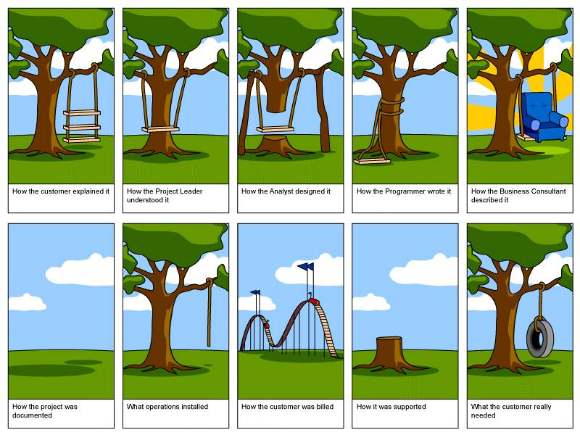
P1: Requirements Management Plan
“conditions or capabilities that must be met by the project or present in the product, service, or result to satisfy an agreement or other formally imposed specification”

Slide 8
P2: Collecting Requirements
For some IT projects, it is helpful to divide requirements development into categories called elicitation, analysis, specification, and validation

Slide 9
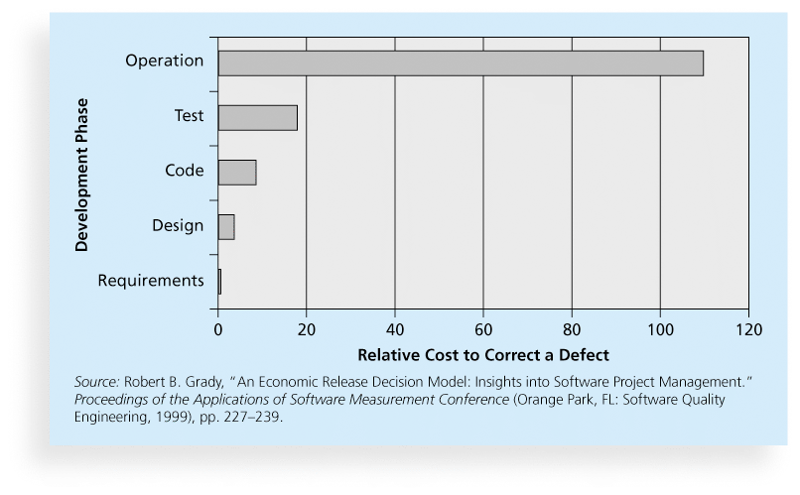
Relative Cost to Correct a Software Requirement Defect

Slide 10
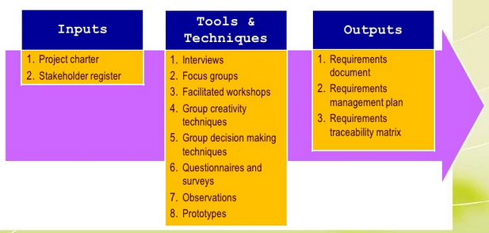
P2: Methods for Collecting Requirements
Interviewing
Prototyping
Benchmarking

Slide 11
P2:Requirements Traceability Matrix
A requirements traceability matrix (RTM) is a table that lists requirements, various attributes of each requirement, and the status of the requirements to ensure that all requirements are addressed

Slide 12
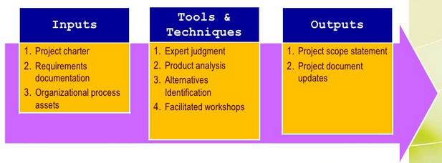
P3: Defining Scope
Project scope statements should include at least:
a product scope description
product user acceptance criteria
detailed information on all project deliverables.

Slide 13
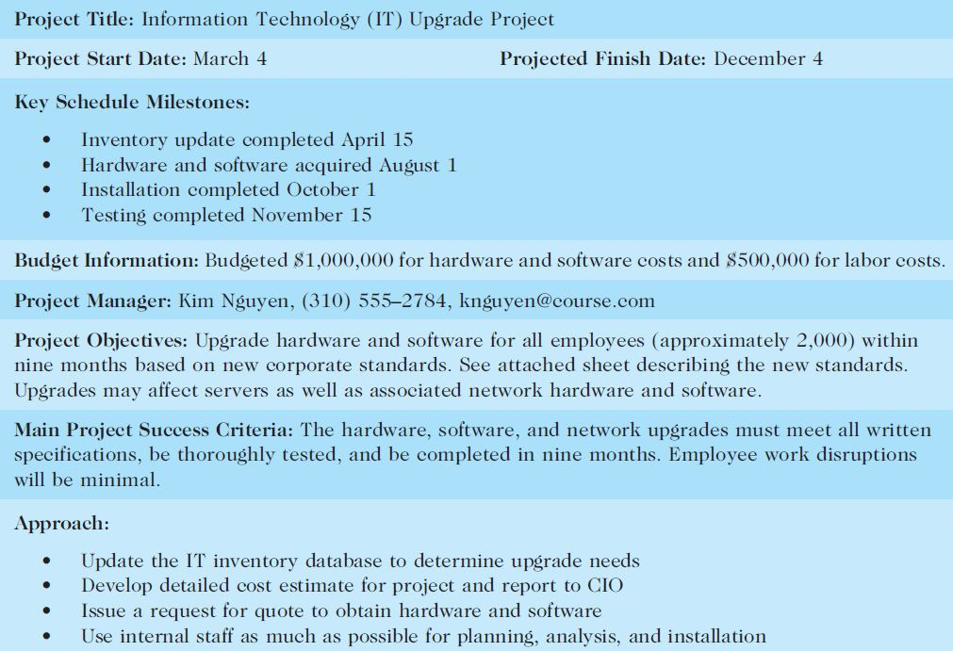
Sample Project Charter (partial)

Slide 14
Refining Project Scope

Slide 15
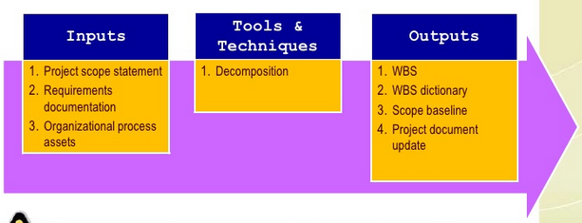
P4: Creating the Work Breakdown Structure (WBS)
A WBS is a deliverable-oriented grouping of the work involved in a project that defines the total scope of the project

Slide 16
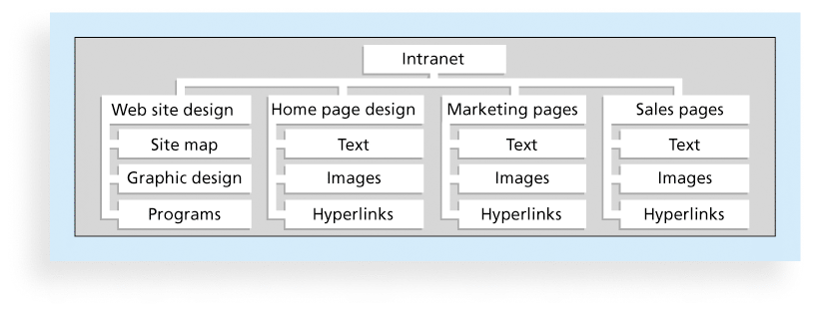
P4: Sample Intranet WBS (Organized by Product )

Slide 17
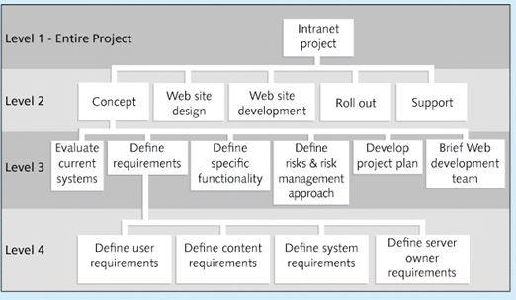
P4: Sample Intranet WBS (Organized by Phase)

Slide 18
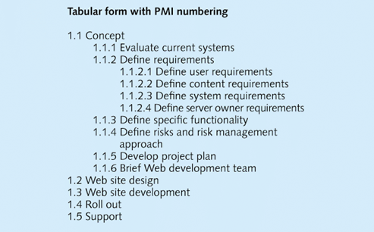
P4: Sample Intranet WBS (Organized by Phase)
Level 2
Level 3
Level 4

Slide 19
PMI Practice Standard for WBS 100 % Rule
WBS should include 100% of the work defined by the project scope and capture ALL deliverables (internal, external, interim) in terms of work to be completed

Slide 20
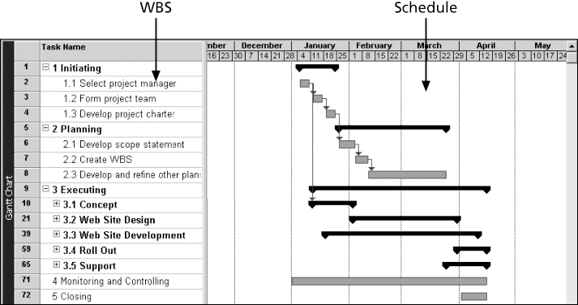
P4: Intranet Gantt Chart Organized by Project Management Process Groups

Slide 21
Approaches to Developing a WBS
Using guidelines: Some organizations, like the DOD, provide guidelines for preparing WBSs
analogy approach
top-down approach
bottom-up approach
Mind-mapping approach

Slide 22
Sample Mind-Mapping Approach for Creating a WBS

Slide 23
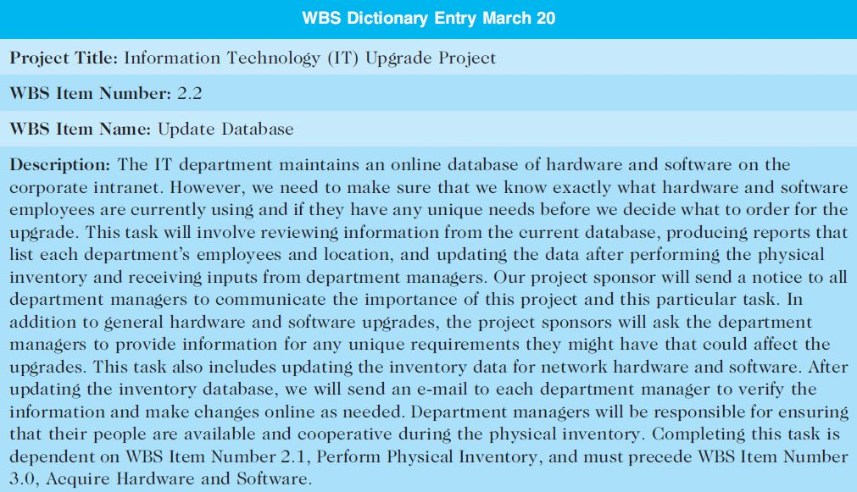
The WBS Dictionary and Scope Baseline
Many tasks are vague and must be explained more so people know what to do and can estimate how long it will take and what it will cost
WBS Dictionary

Slide 24
Advice for Creating a WBS and WBS Dictionary
Unit of work should appear only once in WBS.
Work content of WBS item is sum of items below
Limit responsibility of a WBS item to one individual
(even though many people may be working on it)
Project team member involvement in developing
Document WBS items in WBS Dictionary

Slide 25
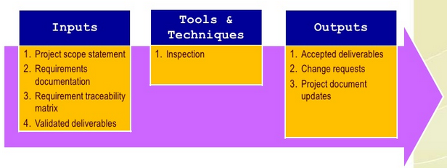
Validating Scope
Scope validation involves formal acceptance of the completed project deliverables
Acceptance is often achieved by a customer inspection and then sign-off on key deliverables

Slide 26
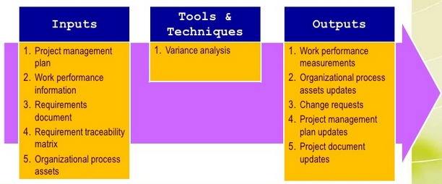
Controlling Scope
Scope control involves controlling changes to the project scope

Slide 27
Controlling Scope
Goals of scope control
influence the factors that cause scope changes
assure changes are processed according to procedures developed as part of integrated change control
manage changes when they occur
Variance is the difference between planned and actual performance

Slide 28
Avoiding Scope Creep
Scope creep may occur as a result of:
Poor change control
Lack of proper initial identification and/or documentation of the features that are required for the achievement of project objectives
Weak project manager or executive sponsor

Slide 29
Scope Creep
To mitigate these types of issues, the proposed solutions are the following:
Define requirements as “must-haves” and “nice to haves”
Set project expectations
Agree on deliverables, and document
Document and review business requirements

Slide 30
Best Practices - Avoiding Scope Problems
1. Keep the scope realistic. Don’t make projects so large that they can’t be completed.
2. Involve users in project scope management.
3. Use off-the-shelf hardware and software whenever possible.
4. Follow good project management processes.

Slide 31
Improving User Input
Develop a good project selection process and insist that sponsors are from the user organization
Have users on the project team in important roles
Have regular meetings with defined agendas, and have users sign off on key deliverables presented at meetings
Deliver something to users and sponsors on a regular basis
Don’t promise to deliver when you know you can’t
Co-locate users with developers

Slide 32
Reduce Incomplete and Changing Requirements
Requirements management process
Use techniques to get user involvement
Document and maintain requirements
Create a requirements management database
Testing throughout the project life cycle
Review changes from a systems perspective

Slide 33
Using Software to Assist in Project Scope Management
Word-processing software helps create several scope-related documents
Spreadsheets help to perform financial calculations, weighed scoring models, and develop charts and graphs
Communication software like e-mail and the Web help clarify and communicate scope information
Project management software helps in creating a WBS, the basis for tasks on a Gantt chart
Specialized software is available to assist in project scope management

Slide 34
Chapter Summary
Project scope management
Main processes include:
Define scope management
Collect requirements
Define scope (scope statement)
Create WBS
Validate scope
Control scope

