Slide 1
Project Cost Management

Slide 2
What is Cost and Project Cost Management?
Cost is a resource sacrificed or foregone to achieve a specific objective or something given up in exchange
Project cost management includes the processes required to ensure that the project is completed within an approved budget

Slide 3
Project Cost Management Processes
Scope Baseline
Schedule Baseline
Estimate bases
Project Funding Req.
Estimate Costs
Determine Budget
Control Costs
Activity Cost Estimates
Cost Baseline

Slide 4
Project Cost Management Processes
Process Group | Cost Management Process | Major Output
Planning | CP1: Planning Cost Mgmt | Cost Management Plan
 | CP2: Estimating Costs | Activity Cost Estimates
 | CP3: Determining the Budget | Cost Performance Baseline
Monitoring and Controlling | MC1: Controlling Costs | Work Perf. Measurements Budget Forecasts

Slide 5
Basic Principles of Cost Management
Most members of an executive board better understand and are more interested in financial terms than IT terms, so IT project managers must speak their language
Profits
Profit margin
Life cycle costing
Cash flow analysis

Slide 6
Types of Costs and Benefits
Tangible costs or benefits
Intangible costs or benefits
Direct costs
Indirect costs
Sunk cost
Basic Principles of Cost Management
Learning curve theory
Reserves
Contingency reserves
Management reserves

Slide 7
CP1: Planning Cost Management
The project team uses expert judgment, analytical techniques, and meetings to develop the cost management plan
A cost management plan includes:
Level of accuracy and units of measure
Organizational procedure links
Control thresholds
Rules of performance measurement
Reporting formats
Process descriptions

Slide 8
CP2: Estimating Costs
Project managers must take cost estimates seriously if they want to complete projects within budget constraints
It’s important to know the types of cost estimates, how to prepare cost estimates, and typical problems associated with IT cost estimates
Input
1) HR Plan 2) Project Schedule 3) Scope Baseline 4) Risk Register
Tools/Techniques
1) Estimating Techniques 2) Cost of Quality 3) Reserve Analysis 4) PM Estimate Software 5) Expert Judgment
Output
1) Activity cost estimates 2) Estimate Bases 3) Update docs

Slide 9
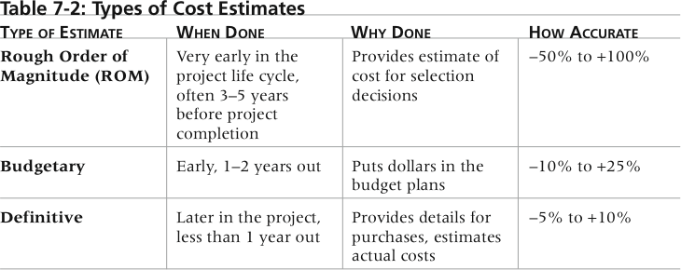
Categories of Cost Estimates
The number and type of cost estimates vary by application area.

Slide 10
Cost Estimation Techniques
Basic tools and techniques for cost estimates:
Top-down estimates
Analogous
Parametric modeling

Slide 11
Cost Estimation Techniques
Basic tools and techniques for cost estimates:
Bottom-up estimates
PERT
Ex. The pessimistic cost estimate for an activity is $11,000, the optimistic estimate is $3,000 and the most likely estimate is $4,000. What should you use for the expected estimate?

Slide 12
Using Estimation Techniques
Top-Down Technique
Externally: used by organizations completing IT projects for other companies
Internally: can be used for similar projects
Problem
You are dealing with IT
Less Accurate Estimates

Slide 13
Using Estimation Techniques
Bottom-up Technique
Based on the WBS
Creates a detailed estimate of each work component
More Accurate
Can separate across phases
Would be better for controlling costs

Slide 14
Typical Problems with IT Cost Estimates
Estimates are done too quickly
People lack estimating experience
Human beings are biased toward underestimation
Management desires accuracy
Contingency reserve is often used to reduce the risk from these problems

Slide 15
PM Network: Estimating Errors
“treat estimates as a living process and not a one time event.”
Approaches
Matching Skill Sets
Share Accountability

Slide 16
CP3: Determining the Budget
Cost budgeting involves allocating the project cost estimate to individual work items over time
The WBS is a required input to the cost budgeting process since it defines the work items
Reserve analysis must occur
Contingency reserves
Management reserves

Slide 17
CAPM – Things to know
Project budget is time-phased project cost (aggregating individual activity costs)
Contingency Reserves
Deal with uncertainties in schedule/cost
Deal with overruns of the project objectives
Analogous estimating takes less time but is also less accurate
Memorize the formulas for EV, CV, CPI, PV, SV, SPI

Slide 18
MC1: Controlling Costs
Project cost control includes
Monitoring cost performance
Ensuring that only appropriate project changes are included in a revised cost baseline
Informing project stakeholders of authorized changes to the project that will affect costs
Many organizations around the globe have problems with cost control
Work Performance Measurement helps

Slide 19
Performance Measurement Analysis
Earned Value Management
Given a baseline (original plan plus approved changes), you can determine how well the project is meeting its goals
You must enter actual information periodically to use EVM
Based on:
Planned value (PV)
Actual cost (AC)
Earned value (EV)

Slide 20
Rate of Performance
Rate of performance (RP)
Ratio of actual work completed to the percentage of work planned to have been completed
For example, suppose the server installation was halfway completed by the end of week 1. The rate of performance would be 50% because by the end of week 1, the planned schedule reflects that the task should be 100 percent complete and only 50 percent of that work has been completed

Slide 21
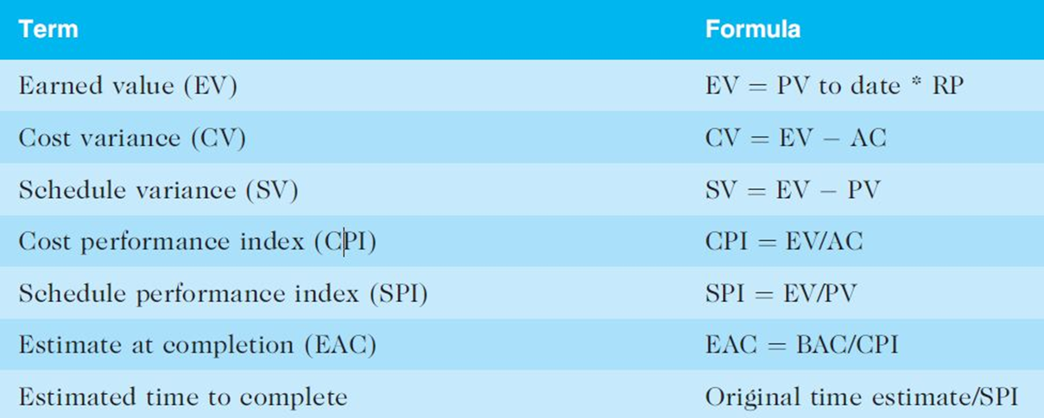
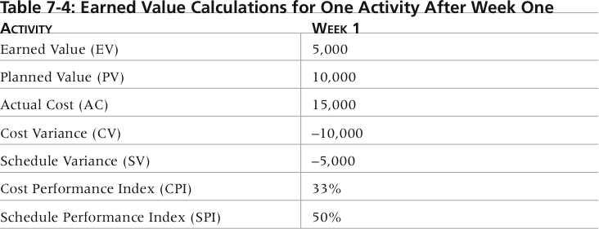
Earned Value Calculations for One Activity After Week One

Slide 22
Rules of Thumb for EV Numbers
Negative numbers for cost and schedule variance indicate problems in those areas
CPI and SPI less than 100% indicate problems
Problems mean the project is costing more than planned (over budget) or taking longer than planned (behind schedule)
The CPI can be used to calculate the estimate at completion (EAC)—an estimate of what it will cost to complete the project based on performance to date. The budget at completion (BAC) is the original total budget for the project

Slide 23
Chapter Summary
Project cost management is a traditionally weak area of IT projects, and project managers must work to improve their ability to deliver projects within approved budgets
Main processes include
Plan cost management
Estimate costs
Determine the budget
Control costs

