Slide 1
Procurement Management

Slide 2
Importance of Project Procurement Management
Procurement means acquiring goods and/or services from an outside source
Other terms include purchasing and outsourcing
Experts predict that global spending on computer software and services will continue to grow

Slide 3
Why Outsource?
To access skills and technologies
To reduce both fixed and recurrent costs
To allow the client organization to focus on its core business
To provide flexibility
To increase accountability

Slide 4
Contracts
A contract is a mutually binding agreement that obligates the seller to provide the specified products or services and obligates the buyer to pay for them
Contracts can clarify responsibilities and sharpen focus on key deliverables of a project
Because contracts are legally binding, there is more accountability for delivering the work as stated in the contract

Slide 5
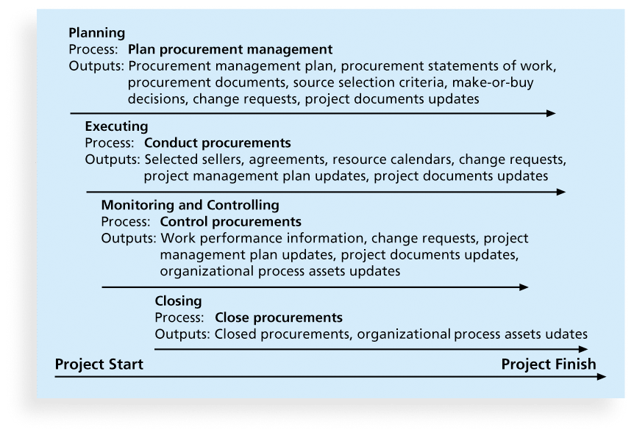
Project Procurement Management Processes
Project procurement management: Acquiring goods and services for a project from outside the performing organization
Processes include:
Planning procurement management
Conducting procurements
Controlling procurements
Closing procurements

Slide 6
Planning Procurement Management
Identifying which project needs can best be met by using products or services outside the organization
Types of Contracts:
Fixed Price (or lump sum)
Cost Reimbursable
Time and Material
Unit Price

Slide 7
Point of Total Assumption
The Point of Total Assumption (PTA) is the cost at which the contractor assumes total responsibility for each additional dollar of contract cost
Contractors do not want to reach the point of total assumption, because it hurts them financially, so they have an incentive to prevent cost overruns
The PTA is calculated with the following formula:
PTA = (ceiling price – target price)/government share + target cost

Slide 8
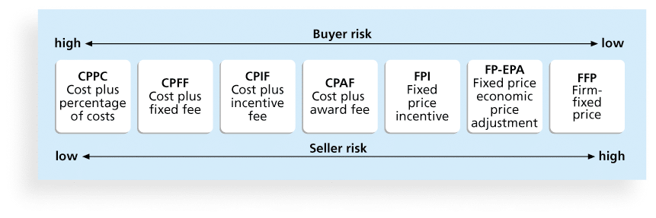
Cost Reimbursable Contracts
Cost plus incentive fee (CPIF)
Cost plus fixed fee (CPFF)
Cost plus percentage of costs (CPPC)

Slide 9
Contract Clauses
Contracts should include specific clauses to take into account issues unique to the project
Can require various educational or work experience for different pay rights
Often includes:
Termination clause
Limitation of liability clause

Slide 10
Tools and Techniques for Planning Purchases and Acquisitions
Expert judgment
Market research
Make-or-buy analysis: General management technique used to determine whether an organization should make or perform a particular product or service inside the organization or buy from someone else

Slide 11
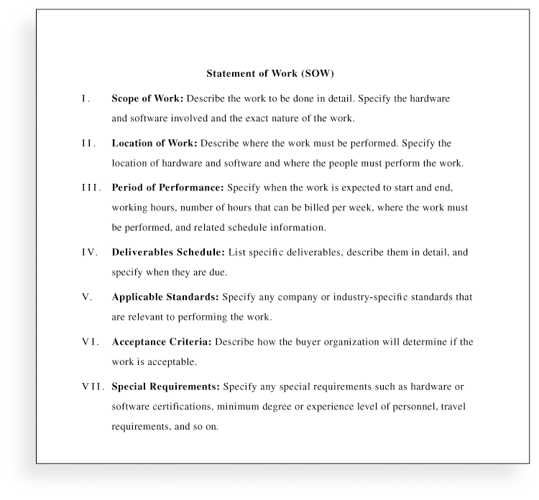
Contract Statement of Work (SOW)
A statement of work is a description of the work required for the procurement
If a SOW is used as part of a contract to describe only the work required for that particular contract, it is called a contract statement of work

Slide 12
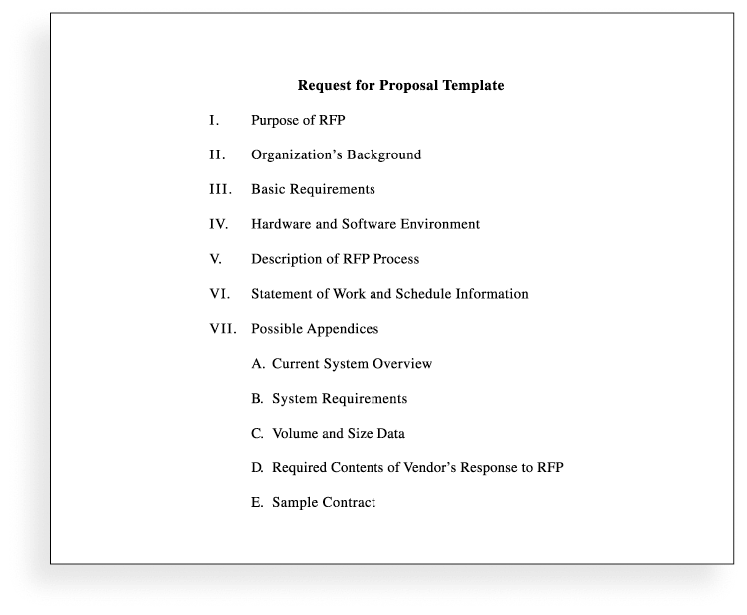
Procurement Documents
Request for Proposals
Proposal
Requests for Quotes
Bid

Slide 13
Source Selection Criteria
It’s important to prepare some form of evaluation criteria, preferably before issuing a formal RFP or RFQ
Beware of proposals that look good on paper; be sure to evaluate factors, such as past performance and management approach

Slide 14
Conducting Procurements
Deciding whom to ask to do the work
Sending appropriate documentation to potential
sellers
Obtaining proposals or bids
Selecting a seller
Awarding a contract

Slide 15
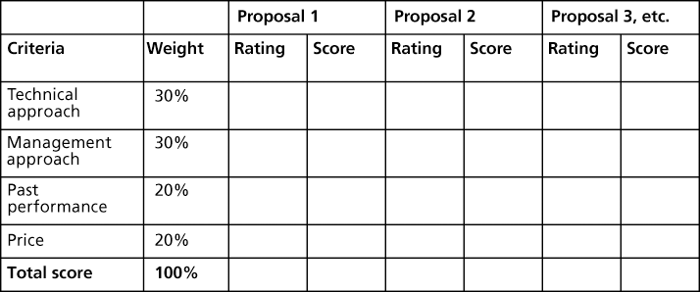
Approaches for Procurement
Organizations can advertise to procure goods and services in several ways:
Approaching the preferred vendor
Approaching several potential vendors
Advertising to anyone interested

Slide 16
Seller Selection
Organizations often do an initial evaluation of all proposals and bids and then develop a short list of potential sellers for further evaluation

Slide 17
Controlling Procurements
Ensures that the seller’s performance meets contractual requirements
Contracts are legal relationships, so it is important that legal and contracting professionals be involved in writing and administering contracts
It is critical that project managers and team members watch for constructive change orders

Slide 18
Suggestions for Change Control in Contracts
Evaluation of any change should include an impact analysis. How will the change affect the scope, time, cost, and quality of the goods or services being provided?
Changes must be documented in writing. Project team members should also document all important meetings and telephone phone calls

Slide 19
Closing Procurements
The project team should:
Determine if all work was completed correctly and satisfactorily
Update records to reflect final results
Archive information for future use
The contract itself should include requirements for formal acceptance and closure

Slide 20
Tools to Assist in Contract Closure
Procurement audits identify lessons learned in the procurement process
Negotiated settlements help close contracts more smoothly
A records management system provides the ability to easily organize, find, and archive procurement-related documents

Slide 21
Chapter Summary
Project procurement management involves acquiring goods and services for a project from outside the performing organization
Processes include:
Plan procurement management
Conduct procurements
Control procurements
Close procurements

